Slide 1
SNF RRAM Standard Process Flow and Characterization of Lesker-2 TiN
ENGR241 Final Presentation
Project Members: Akash Levy, Jung-Soo Ko
Staff Mentors: Michelle Rincon, Vijay Narasimhan, J Provine, Usha Raghuram

Slide 2
Aim & Goals
Test and characterize ALD RRAM devices
Develop TiN recipe on new Lesker with low oxygen contamination
Compare TiN properties (composition, resistivity, topography)
Make electrical/imaging data and test structure layouts available to SNF
Make SOPs for RRAM stacks and report TiN findings
Process Flow Development
Parameter Optimization
Comprehensive Documentation
SNF Database

Slide 3
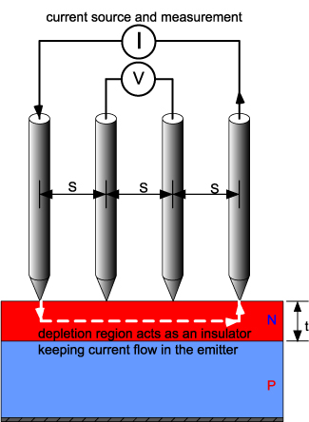
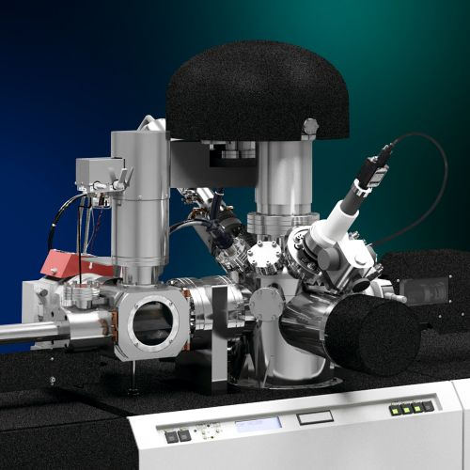
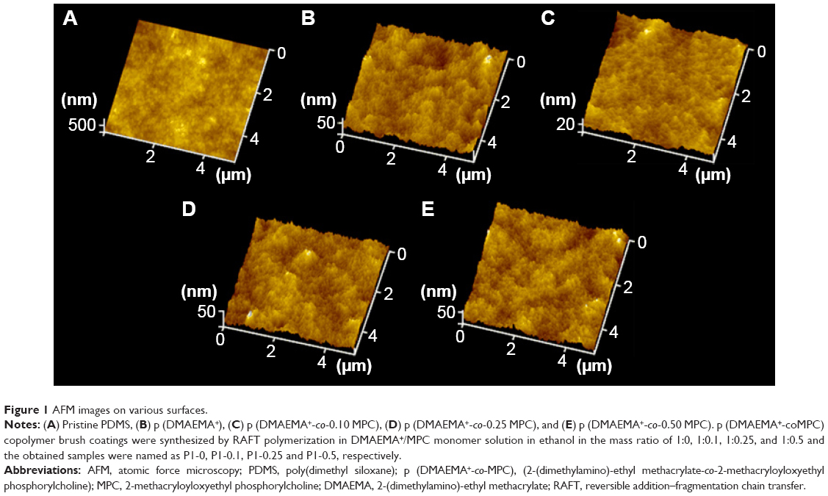
TiN Sample Preparation & Characterization
TiN
(Not drawn to scale)
SiO₂
SiO₂
Si
Si
Si
Start with Si wafer
Standard RCA Clean
Dry grow 100nm SiO₂
(thermco)
Sputter 30nm TiN
Compare 3 sputtering tools: Lesker-1 (SNF), Lesker-2 (SNF), AJA (non-SNF)
Prometrix Resistivity
XPS Composition + Milling
AFM Surface Roughness
AFM Step Height

Slide 4
Literature Review on TiN Sputtering
TiN films absorb a high concentration of contaminants including hydrogen, carbon, and oxygen when they are exposed to air after deposition
With the target–substrate distance set to 88 mm the contaminant levels increase from ∼0.1% to ∼10% as the pressure is increased from 2 to 9 mTorr
The contaminant concentrations also correlate with in-plane distance from the center of the substrate and increase by roughly two orders of magnitude as the target–substrate distance is increased from 88 to 266 mm
Contaminants strongly influence properties of TiN thin films
Resistivity of stoichiometric films increases by around a factor of 5 as the oxygen content increases from 0.1% to 11%
Energy of the sputtered TiN particles plays crucial role in determining the film properties
Important to precisely control the energy of these particles to obtain high-quality TiN
Ohya, S., B. Chiaro, A. Megrant, C. Neill, R. Barends, Y. Chen, J. Kelly et al. "Room temperature deposition of sputtered TiN films for superconducting coplanar waveguide resonators." Superconductor Science and Technology 27, no. 1 (2013): 015009.

Slide 5
AJA TiN Sputter Recipe: Reactive Sputtering
Target: Ti
RF Power: 200W
150W also ok; different dep rates
Wafer Bias: 100V
DC bias 92-94V on AJA in practice
Ar Flow: 30 sccm
N Flow: 3 sccm
Unit conversion means that this is written as 30 on AJA somehow
Set Pressure: 2.15 mTorr
1.8-1.9 mTorr on AJA in practice
Recipe:
Load sample and wait for 1e-7 base chamber pressure
Plasma on another target (conductive) e.g. Al, GeTe
Eases plasma ignition for TiN target
Plasma on Ti target
Bias on other target off
20s ramp-up of Ti target RF power
2 minutes pre-sputtering of Ti target (shutter closed, no wafer bias)
20s ramp-up of wafer bias
Open shutter and deposit for X seconds
Close shutter
20s ramp-down of Ti target RF power

Slide 6
TiN Properties
Seems to have different deposition rates for glass and Si
Probably difference in effect of wafer bias!
 | AJA: A1 | Lesker-1: X2 | Lesker-1: X3 | Lesker-1: X4 | Lesker-2: Y1 | Lesker-2: Y2 | Lesker-2: Y3 | Lesker-2: Y4
Target/Wafer | Ti/Si+SiO₂ | TiN/Si+SiO₂ | TiN/Si+SiO₂ | TiN/Si+SiO₂ | TiN/Si+SiO₂ | TiN/Si+SiO₂ | TiN/glass | TiN/glass
Base Pressure | ~1e-7 Torr | ~1e-6 Torr | ~3e-6 Torr | ~1e-6 Torr | ~1e-7 Torr | ~4e-9 Torr | ~1e-8 Torr | ~2e-8 Torr
RF Power | 200W | 200W | 200W | 200W | 200W | 200W | 250W | 150W
Gettering/ Chamber | 2 min TiN ↑ | 5 min Ti pre, 5 min TiN ↑ | 10 min Ti pre, 5 min TiN ↑ | 5 min Ti pre, 5 min TiN ↑ | 5 min TiN pre, 5 min TiN ↑ | 30 min TiN pre, 5 min TiN ↑ | 30 min TiN pre, 5 min TiN ↑ | 30 min TiN pre, 5 min TiN ↑
Wafer Bias | 100V | 100V | 100V | 100V | 100V | 100V | 100V | 100V
Ar/N Flow | 30/3 sccm ↓ | 30/3 sccm ↓ | 30/3 sccm ↓ | 30/0 sccm ↓ | 11.5/0 sccm ↑ | 11.6/0 sccm ↑ | 11.5/0 sccm ↑ | 11.5/0 sccm ↑
Pressure | 2.15 mTorr | 30->3 mTorr | 20->2 mTorr | 20->2 mTorr | 15->5->2 mTorr | 15->5->2 mTorr | 15->5->2 mTorr | 15->5->2 mTorr
Sheet Resistance | 15.650 Ω/□ | 2428.0 Ω/□ | 304.8 Ω/□ | 129.9 Ω/□ | 121.2 Ω/□ | 54.4 Ω/□ | 43.5 Ω/□ | 110.2 Ω/□
Resistivity | 67.25 uΩ cm | 6313 uΩ cm | 927 uΩ cm | 519.6 uΩ cm | 969.6 uΩ cm | 217.6 uΩ cm | 326.2 uΩ cm | 639.2 uΩ cm
Uniformity/Color | Excellent | Not Good | Okay | Okay | Okay | Okay | Okay | Okay
Thickness/Time | 43nm/1800s | 26nm/900s | 30nm/1800s | 40nm/1800s | 80nm/1800s | 40nm/1800s | 75nm/1800s | 58nm/1800s
Roughness | 0.67nm | 1.79nm | 1.66nm | 1.37nm | 0.86nm | 1.28nm | ? | ?
Composition (Ti:N:O) | 47:52:1 | 38:39:23 | 43:43:14 | 43:43:14 | 46:41:13 | 47:40:13 | 45:42:13 | 48:45:7

Slide 7
RRAM Process Flow Outline
SiO₂
SiO₂
SiO₂
(Not drawn to scale)
Pt
Pt
Si
Si
Si
Start with Si wafer
Standard RCA Clean
Deposit 10nm Ti, 30nm Pt (AJA),
150nm SiO₂ (ccp-dep)
Pattern trenches (PT-Ox)
Post-metal clean
Active device area
SiO₂
SiO₂
SiO₂
SiO₂
SiO₂
SiO₂
TiN
TiN
HfO₂
HfO₂
HfO₂
Pt
Pt
Pt
Si
Si
Si
Pattern top electrodes (PT-MTL)
Post-metal clean
Sputter 30nm TiN
Deposit 10nm HfO₂ (Fiji)

Slide 8
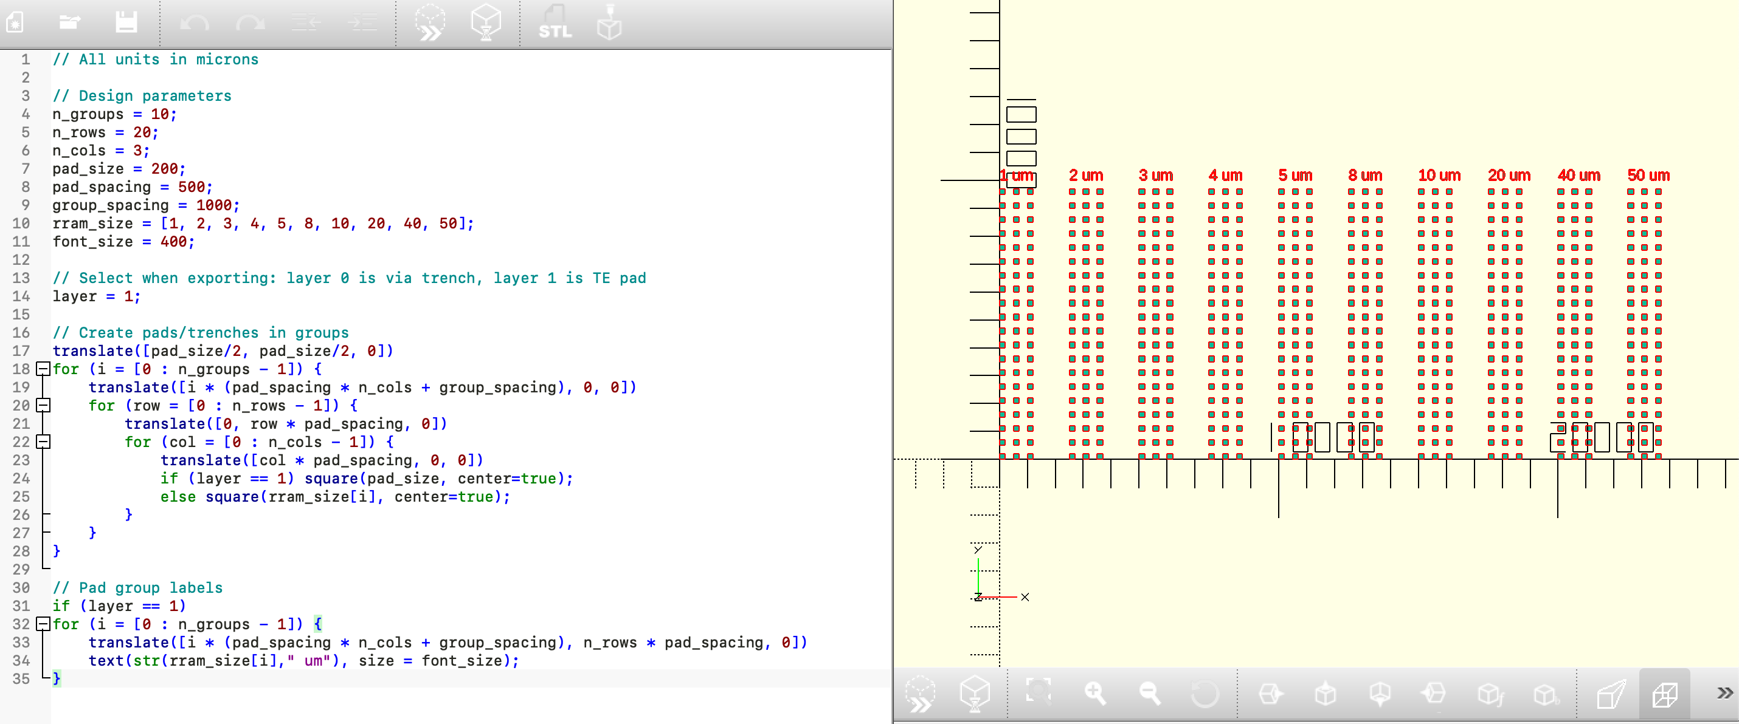
Layout Generator

Slide 9
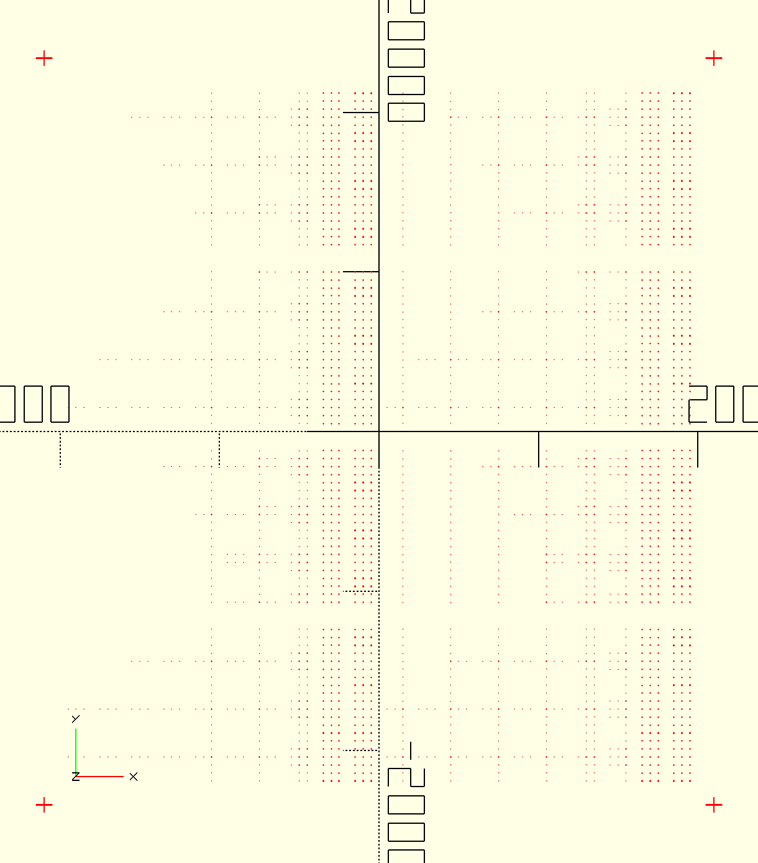
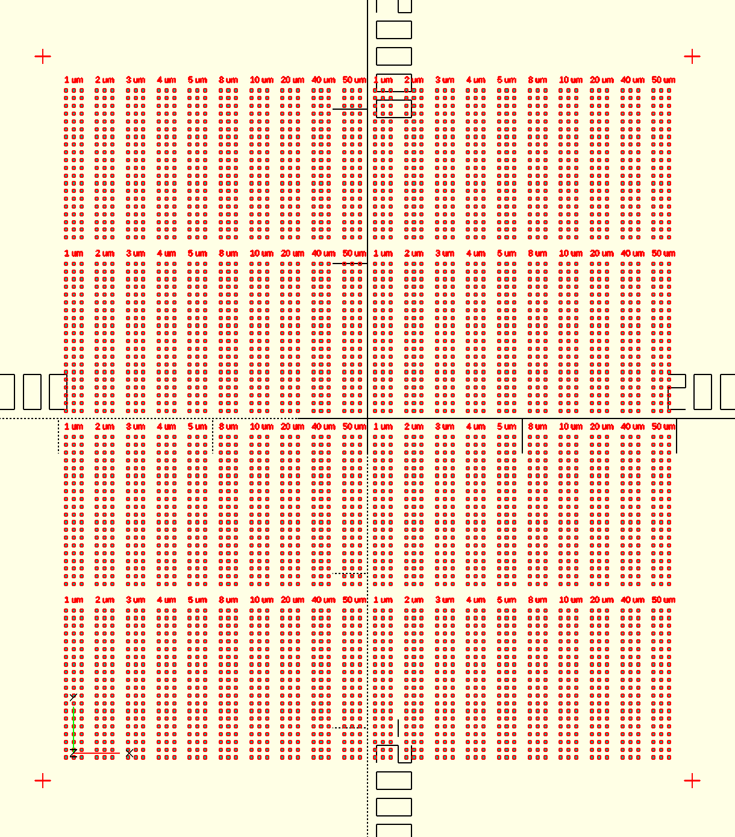
Layout Generator
Trench Layer
Top Electrode Layer
Finalized layout: alignment marks, tiling, centering about origin to make Heidelberg usage easier
Design dimensions: about 4cm x 4cm, (20x3 array) x (4x2 grid) devices per size with 10 device sizes

Slide 10
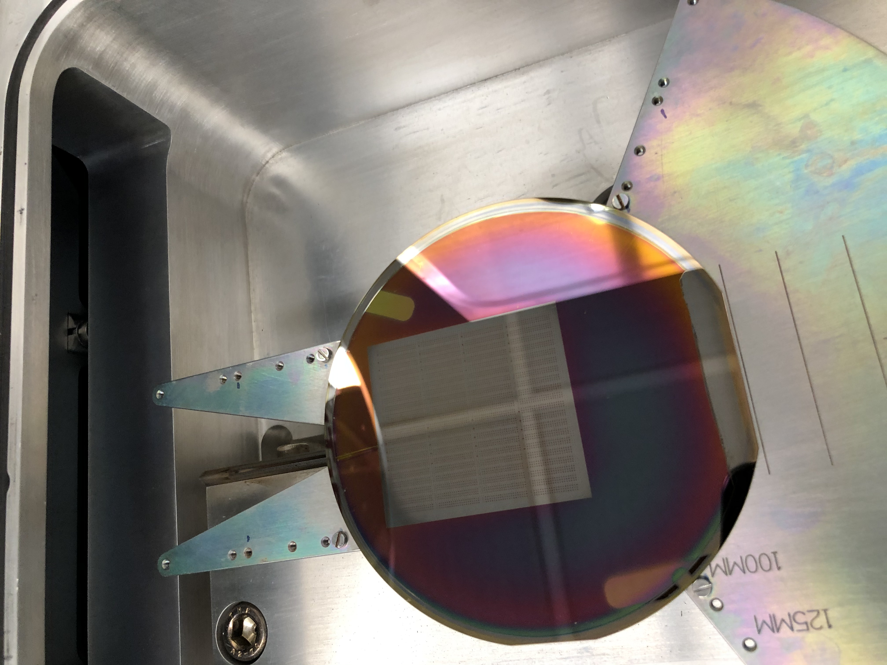
R1: RRAM that FORMs and RESETs ☺
Fixes to process flow:
Lesker-2 TiN was used
Color looked similar to blanket depositions on Si
Resistivity confirmed to be relatively low
60s etch in PT-MTL:
Photoresist appears to still be present ☺
Uncovered areas expose Pt
No matrix ash: straight to SRS-100/PRS-1000
Results so far:
(40 um x 40 um) devices work!
Can FORM, RESET great
SET is having issues: over-SET

Slide 11
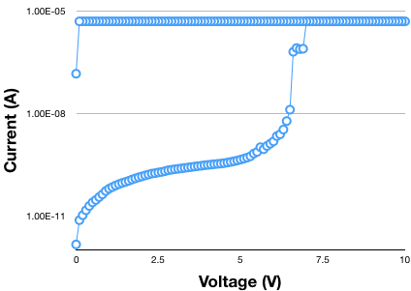
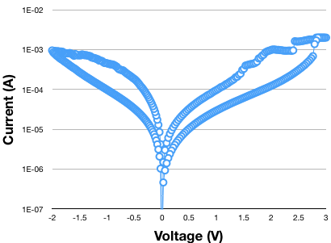
Preliminary RRAM Characteristics (40um x 40um)
FORMING
RESET

Slide 12
Final Week
Characterizing R1 devices:
Tuning test setup for SET to prevent over-SET problem
Slow sweep and compliance current adjustment
Fabricating/characterizing TiN devices that Graham though would be useful
XPS on Lesker-2 TiN samples
Surface roughness on all TiN samples
Community service project goals:
Characterize TiN deposition rate
Compare to reactive sputtering with Ti target
RRAM sample optimization and statistical analysis

Slide 13
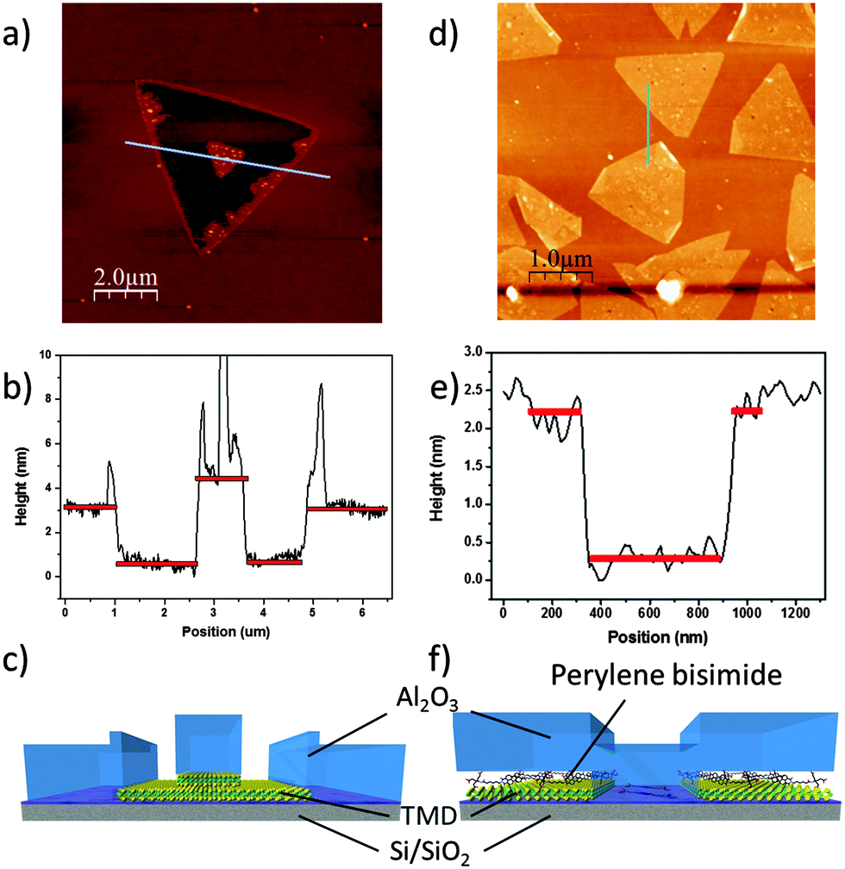

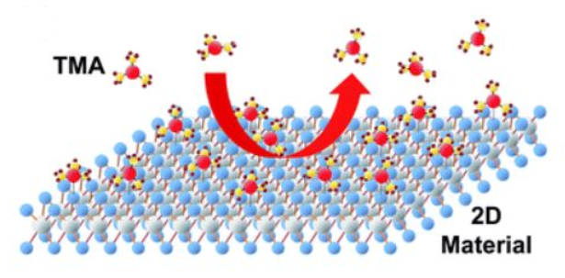
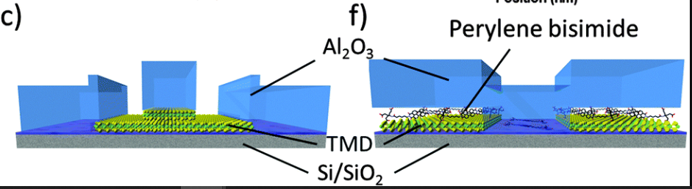
Challenges of ALD on 2D
Surface functionalization required to create nucleation sites!
Challenges with ALD on 2D materials:
Lack of dangling bonds
→ No nucleation sites
Difficult to make top gated structure!
C. Wirtz et al., RSC, 2015.
C. Park, H. Kim et al., RSC Adv., 2017.
Precursor
Notes:
Instead of using TMA, use precursor
Edit the right figures

Slide 14
Top Gating 2D FET: Process Flow
ALD oxide
ALD oxide
Contact Pads for Probing
Metal-MoS₂ Contact
Channel Definition
Metal Gate Deposition
Etching through Oxide for Probing
Seed
Au
Seed
Au
Au
Ti
ALD oxide
Seed
MoS₂
SiO₂
P++ Si

Slide 15
Thank you!
Questions?

